Slide 1
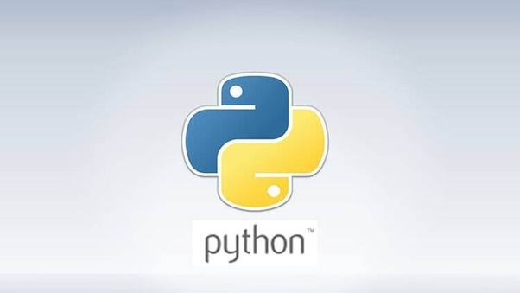
Python DataCamp Course
Client: Dr. Nelson & SMU Computer Science Program
Prepared By: Matthew Hancock & Rachel Burk
Content: Python For Everybody

Slide 2

Identify the Client’s Needs
Creating an introductory python course based off the material from the book “Python for Everybody” for the university’s CSC101 introductory programming language class.

Slide 3
Objective and Motivation
It is our goal to create and comprehensive and useful DataCamp course that will be used to teach students in an accessible and engaging medium.
We believe that we could apply our programming skills to benefit future computer science students of Saint Martin’s University.
This DataCamp course would most likely be used in CSC101 to introduce programming to future computer science students.

Slide 4
Methodology
Learning objectives include the following:
Condition - the condition under which the student will perform the described behavior
Behavior - a description of a specific, observable behavior
Degree - the degree indicates the desired level or degree of acceptable performance
Objectives must be measurable:
Interactive activities and assessments to guide learning

Slide 5
Implementation and Documentation
Implementation will take place through GitHub and DataCamp Light.
Performing this process with GitHub allows us to document and implement the material.
We will only be completing the first six chapters worth of online course through DataCamp.
Documentation will be necessary for future teams who continue our work.

Slide 6
Learning Objectives
Module 1: Introduction to the python course and explanation of additional resources as well as giving credit to the Python for Everybody book and content.
Module 2: Variables, expression and statements. In this module we will be covering the basics of programming languages. With a large focus on values, types, variables and operators. We will also cover the computer uses order of operations to make sense of the code.
Module 3: Conditional Execution. Introduce Boolean Expressions and Logical Operations. We will also cover conditional execution and different kinds of conditionals.
Module 4: Functions. Introduce how to call and declare functions. Discuss and explain the definition of a function and its uses in programming.
Module 5: Iteration. This chapter will have a focus on iteration and looping. We will introduce the basics of for and while loops as well as the dangers of infinite looping.
Module 6: Strings. We will take about the basics of strings and how they are used in programming. We will cover string methods, comparison and the importance of parsing strings.
Module 7: Files. We will cover the basics of writing and reading to files in a directory. We will cover what persistence means as well as how to search through a file and edit it.

Slide 7
Schedule for CSC482
Item | Scheduled Due Date
Module 1: Brief Intro to Python & DataCamp | Week 1: 8/26 – 8/30
Module 2: Variables, Expressions and Statements | Weeks 2 & 3: 9/2 – 9/13
Module 3: Conditional Execution | Weeks 4 & 5: 9/16 – 9/27
Module 4: Functions | Weeks 6 & 7: 9/30 – 10/11
Intermediate Presentation | Weeks 8 & 9: 10/14 – 10/25
Module 5: Iteration | Weeks 10 & 11: 10/28 – 11/8
Module 6: Strings | Weeks 11 & 12: 11/11 – 11/22
Module 7: Files | Weeks 13 & 14: 11/25 – 12/6
Final Presentation | Week 15 (Finals): 12/9 – 12/12

